Slide 1
Credit Card Spend Prediction

Slide 2
Business problem/objective:
To predict the Credit card spent of a new customer given his details like demographics, personal details, card details etc.
This is a Regression problem where we would build a model to predict the Credit card spent of new customer.
Data Understanding:
Total number of variables : 130.
Target variables is derived as follows:
Total Spend = cardspent + card2spent
Algorithms used:
Decision Tree Regressor
XGBoost Regressor
KNN Regressor

Slide 3
Data Exploratory Analysis
There were insignificant variables and duplicate variables. So, dropped the following variables:
Categorical variable for numerical feature.
Log of a continuous feature.
Strong correlation between these numerical variables.
Doesn't help in building the model.
(i) (ii) (iii) (iv)
agecat
edcat
employcat
spousedcat
inccat
addresscat
cardtenurecat
card2tenurecat
lninc
lncreddebt
lnothdebt
lnlongmon
lnlongten
lntollmon
lnwireten
lntollten
lnequipmon
lnequipten
lncardmon
lncardten
lnwiremon
card2tenure
longten
custid

Slide 4
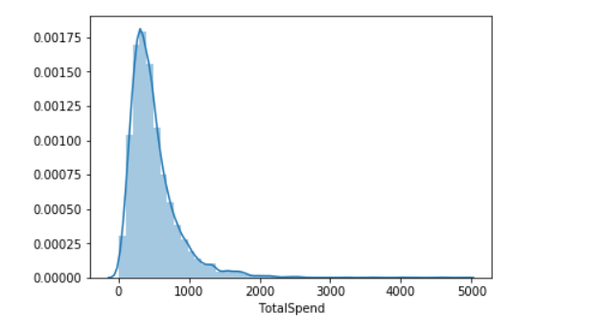
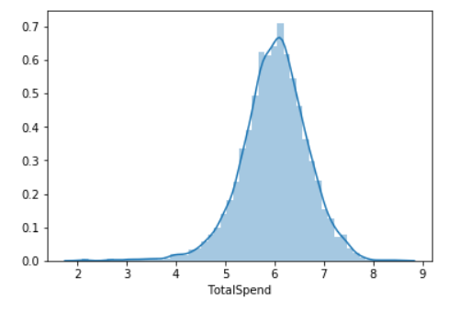
Distribution:
The Total Spend is not following normal distribution. So, transformation is needed to convert it into normal
distribution.
On applying log Transformation, log_TotalSpend follows normal distribution. So, log_TotalSpend will be used as Target.

Slide 5
Outlier Treatment:
UC: 0.99 quartile
LC: 0.01 quartile
All the points less than LC and greater than UC is considered as an outlier and removed.
Missing Treatment:
For numerical variables: Replace the missing values by the mean of the variable.
For categorical variables: Replace the missing values by the mode of the variable.

Slide 6
Feature Engineering:
Variable Reduction:
Applied Correlation between numerical variables and log_TotalSpend variable.
22 numerical variables have been dropped because of very low value of correlation with the target variable.
10 numerical variables have been selected for further model building processes.
Performed ANOVA between Target and each categorical variables:
34 categorical variables have been dropped because of p value less than 0.05.
37 categorical variables have been chosen for further steps.
Dummy Variable Creation:
36 categorical variables are one-hot encoded to generate dummy variables.
1 ordinal variable is used as it is.
62 new categorical variables are created using dummy variable creation.
Total 63 categorical variables are chosen for further steps.

Slide 7
Variable Selection:
SelectKBest
Selected 15 most important variables from the total 73 variables.
Recursive Feature Elimination
Selected 15 most important variables from the total 73 variables.
F- Regression
Selected most important variables using high F-value.
Variation Inflation Factor
Consolidated all the selected variables from above 3 steps and applied VIF.
Selected top 20 variables with vif < 5.
Linear Regression
Built a ols regression model.
Removed the least contributing variables based on p value.
Selected 14 variables for the final model building.

Slide 8
Model pre-requisites/ Model Assumptions:
The Target variable (Total Spend) follows normal distribution.
Outliers have been removed.
No missing values in the data.
Categorical variables have been properly encoded.
Selected < 15 variables for final model building based on reduction techniques.
No multi-collinearity between X variables.
Train and Test split:
Train data = 70 %
Test data = 30 %
Train data will be used to build the model.
Test data will be used to validate the model.

Slide 9
Goodness of fit metrics:
Based on the above metrics, XGBoost Regressor is the best model.

Slide 10
Residual Analysis:

